Slide 1
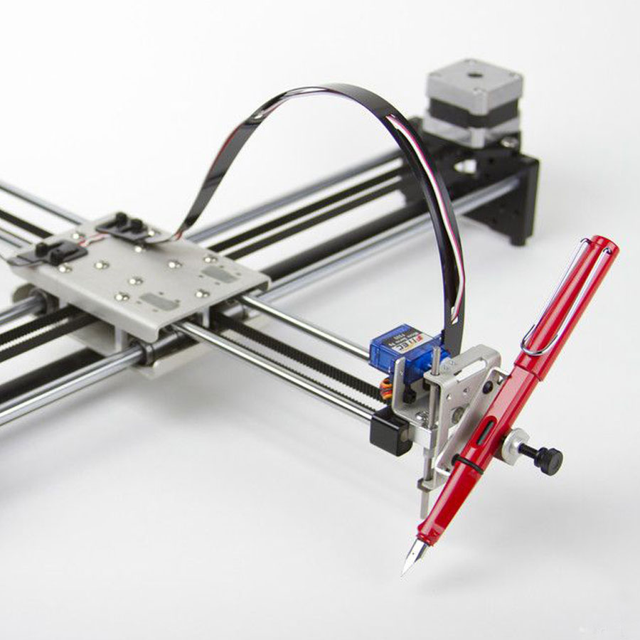
QWERTY Pen Personal Writing Device
Praveen Gnanasekaran & Vijoy Sunil Kumar
Source: AxiDraw
Notes:
Intro:
Name: QWERTY Pen
What it does?
A mechanical writer that could print (write) a text that is input to the device (UART/BT) onto a paper in different fonts or sizes.Also has an LCD interface to select printing options.
Advantages:
Portable,Cheap(ink catridges are costly), can be printed even with pencil-gives a personal touch
hold any type of pen/pencil/colors etc
any type of paper (A4 or less)
Multiple fonts

Slide 2
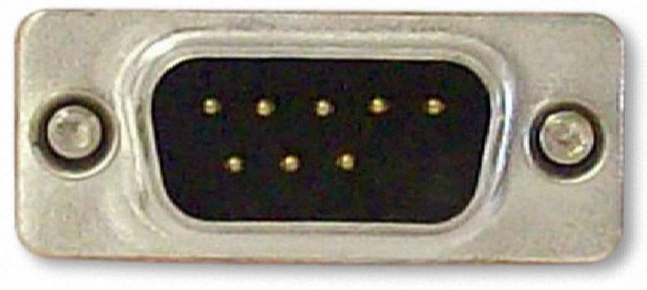
Hardware Implementation
SERVO AND STEPPER MOTORS 1 & 2
1
X
PC
UART
STEPPER
MOTOR
DRIVER
8051
abc
2
PYTHON BITMAP SCRIPT
16x4
LCD
LCD CONTROL BUTTON
Y
Notes:
SERIAL PORT/BLUETOOTH - 8051 – NVSRAM – LCD - STEPPER MOTOR DRIVER
LCD:
Menu
1.Origin set
2.Styles -> Font size/Bold-no Bold/Hollow-fill
3. Quick draw menu: Border plotting, quick shapes (square, rectangle, triangle, circle).
4.Other options (play/pause/stop)
NVSRAM:
Character map code for a particular font from (MATLAB/other ways)
Wireless (BT):
Mobile -> BT -> UART -> 8051

Slide 3
Software Implementation
Host Communication
Character mapping
Features
UART interface
BLUETOOTH Interface
Map stepper motor motion to each character
Adding multiple fonts and sizes
LCD Menu
Play/Pause/Stop
Resume/Cancel work after power fail
Error/Warning messages
Estimated time remaining
Notes:
Interface/comms:
1.BT
2.Uart –interrupt based + buffer
Character mapping- HOW?
Default font:
Default size:
Extra fonts:
Extra size:
Motor control
LCD menu integration-menu items
Alerts/Errors
1.End of paper
2.Font not installed (not found in nvsram)
3.Play/Pause/Stop work in progress
4.Power fail (Resume/Cancel Work)
5.Estimated time remainig

Slide 4
Project milestones
To Do | Current status | Date
Get parts Decide Firmware structure LCD menu setup | Pending Ongoing Pending | 10-31-2016 (WEEK 1) 10-31-2016 (WEEK 1) 10-31-2016 (WEEK 1)
Mechanical setup UART interfacing | Pending Pending | 11-07-2016 (WEEK 2) 11-07-2016 (WEEK 2)
Stepper motor control | Pending | 11-07-2016 (WEEK 2)
Character mapping | Pending | 11-21-2016 (WEEK 3,4)
Single font-single size implementation | Pending | 11-21-2016 (WEEK 3,4)
Bluetooth interfacing Additional features | Pending Pending | 11-28-2016 (WEEK 5) 11-28-2016 (WEEK 5)
Adding extra fonts | Pending | 12-04-2016 (WEEK 6)
Project Documentation | Pending | 12-10-2016 (WEEK 7)
Notes:
Parts to be ordered:
Link/name
Electronics
0.Bluetooth module
1.Motors (separate power supply)
2.Drivers
3.Cables
4.Lcd Switches
Mechanicals
1.Platform
2.Rods (paths)
3.Motor extruders
4.Motor casing
Extra features:-
Alerts/Errors
1.End of paper
2.Font not installed (not found in nvsram)
3.Play/Pause/Stop work in progress
4.Power fail (Resume/Cancel Work)
Quick draw menu

Slide 5
Project deliverables
1
Implement with single font-single size
2
Add Bluetooth and extra features
3
Add extra fonts and sizes
Notes:
Will be completed in 3 stages.
S1: single font-single size
S2: with Bluetooth
S3: with multiple fonts/sizes
Fall back plan -> fall to the previous stage

Slide 6
Thank you.

